Slide 1

Taking Your Institution to the Next Level
From Consumer to Producer

Slide 2

About Me
Banking/Finance for 5 Years
Construction/Consulting Previous 10
Specialize in Infrastructure

Slide 3
Level 1: Consumers
Open Source (OSINT)
Private Sources (FS-ISAC)
Email Lists
“Automated Feeds”
Regulatory Bulletins
Vulnerability Subscriptions

Slide 4
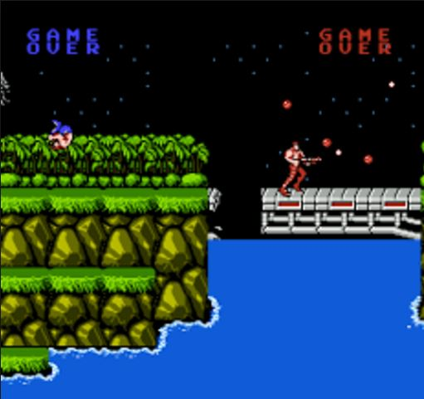
Level 2: Producers
WHY?
Joining the fight…teamwork = victory
Quality vs. quantity

Slide 5

Level 2: Producers
WHY?
Joining the fight…teamwork = victory
Quality vs. quantity
Share, share freely, and share transparently. Make no assumption on valuation, the best intelligence data I tend to receive comes from organizations who understand their environment and the deviation from normalcy. What you may dismiss as without value is an epiphany for someone else that leads to miscreants being punched. Never be embarrassed, afraid, or ashamed to share and ask questions. It's better to be corrected by peers than torn asunder by miscreants; I am corrected often.
Nathan Fowler,

Slide 6
Level 2: Producers
HOW?
Focus on TWO areas: EMAIL & WEB

Slide 7
Level 2: Producers | Email
EMAIL - only requires good MTA visibility and basic tools
Typical items of interest in malicious emails:
Sender IP & host (check if mailbox is pwned vs. spoofed)
Sender mailbox (from/reply-to)
Message attachments or URLs (more on this…)
BEC / wire fraud is great – requires little/no technical abilities to take down their financial infrastructure (mule accounts)

Slide 8
Level 2: Producers | Email
So you have a link or attachment from a malicious email?
Analyzing LINKS (find the “story”)
URLquery & URLscan.io are great
VirusTotal is great (look for any comments)
Other dynamic analysis: Hybrid-Analysis, Malwr, Cuckoo, etc.
Run URL against punch++ / iprep / OSINT Grabber
Static analysis?
Look at redirects & drop files /.js etc.
Take notes! All good stuff…

Slide 9
Level 2: Producers | Email
So you have a link or attachment from a malicious email?
Analyzing ATTACHMENTS
Collect hashes (HashMyFiles)
Run through dynamic analysis
If it’s .js or .vbs dropper try to get payload / rinse & repeat
Getting those domains on droppers is CRITICAL!
Share with community, ask for help convicting it
At a minimum share hash & file name

Slide 10
Level 2: Producers | Web
Web – only requires good logging
Share what is alerted….types of things might include
Sinkhole traffic
Potential “botnet” / C2 traffic
Endpoint accessed malicious domain or IP
Suspicious outbound traffic (non standard ports, etc.) – note that even blocked traffic should be reviewed
Large movement in traffic
EXE / MIME over the wire

Slide 11
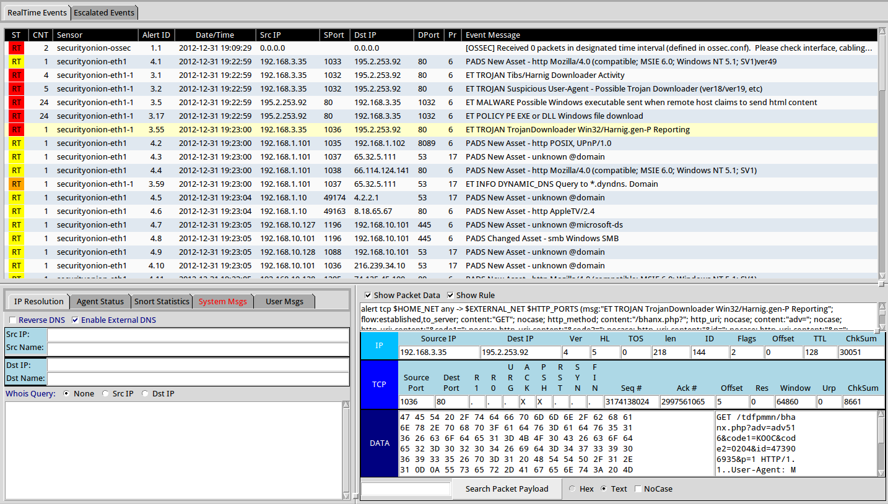
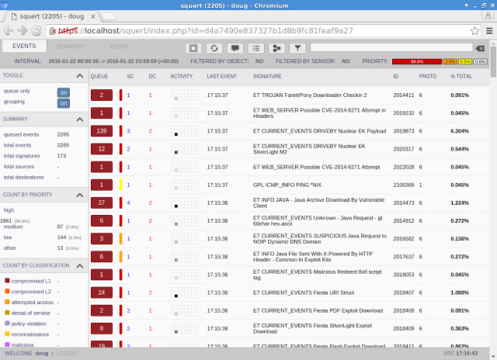
Level 2: Producers
ONE IMPORTANT TOOL…
Security Onion + ET Pro Signature Subscription (run Bro!) + DECRYPT IF POSSIBLE

Slide 12
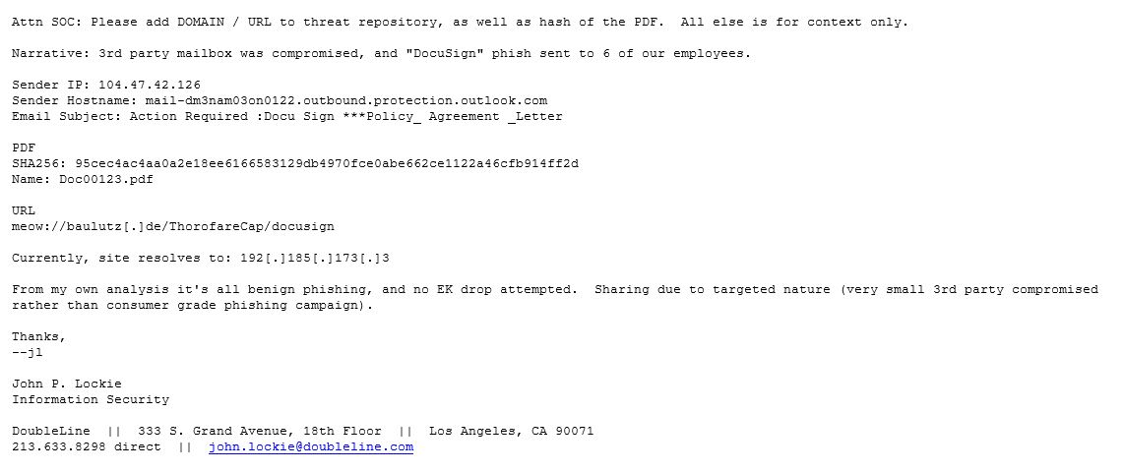
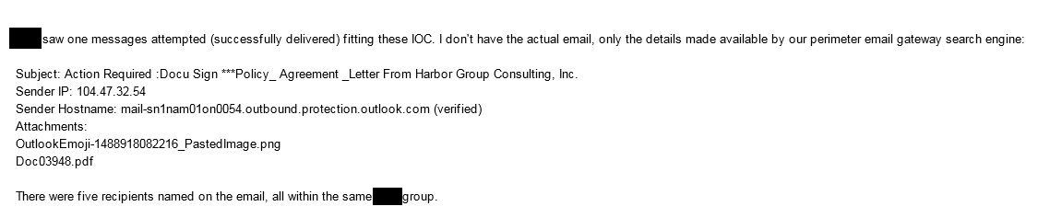

Level 2: Producers
SOME EXAMPLES (story time)

Slide 13
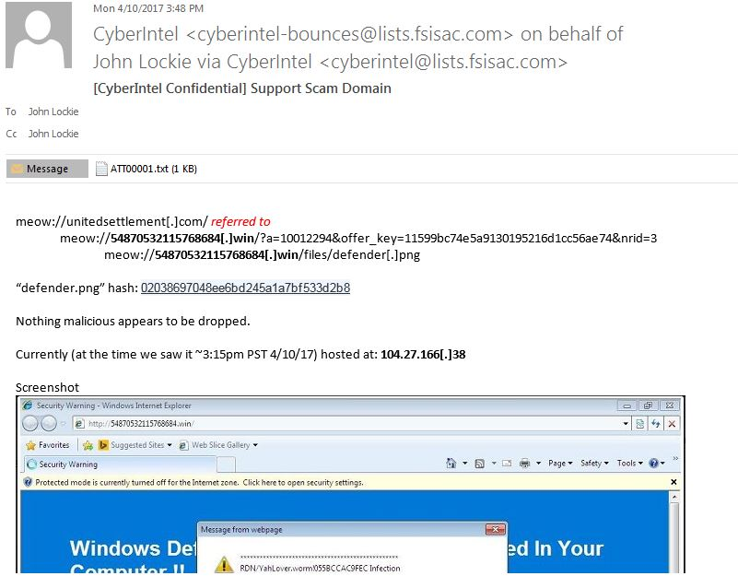
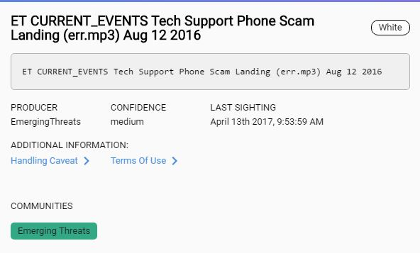
Level 2: Producers
SOME EXAMPLES (story time)

Slide 14
Level 2: Producers
Questions…?
John.Lockie@doubleline.com
@thedefensedude
CyberIntel Confidential List Request Access @ admin@fsisac.com

